Slide 1
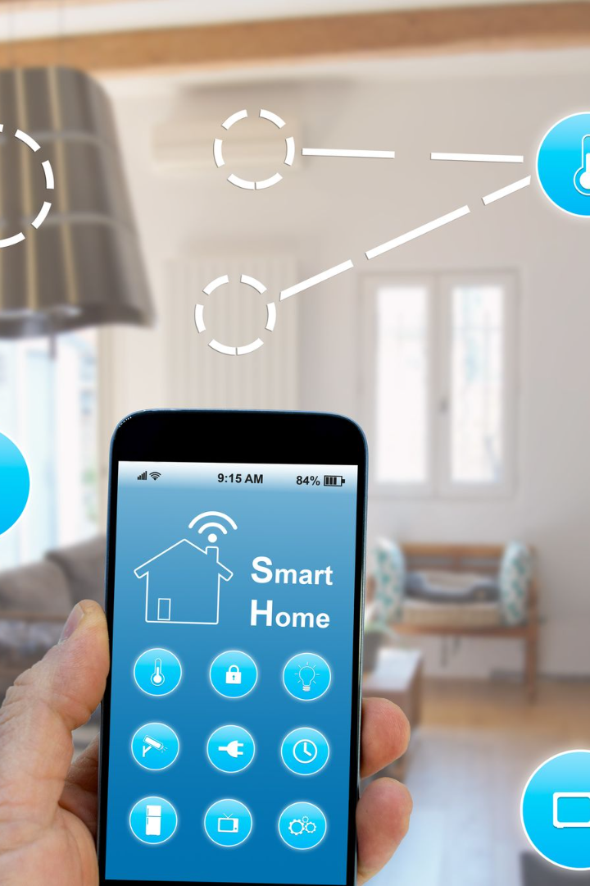
Data Integration: Identify and integrate smart devices into the smart home ecosystem
Welcome to the world of data integration! In this presentation, we will explore the challenges, benefits, and future of integrating smart devices like thermostats, motion sensors, and cameras into the smart home ecosystem
BY
Vishal.M
715021106318.

Slide 2
Challenges of Smart Device Integration
Compatibility
Complex Setup
Data Security
Ensuring that smart devices can seamlessly communicate and interact with each other can be a challenge due to different protocols and standards.
Configuring and connecting multiple devices together can be complicated and time-consuming for homeowners, requiring technical knowledge and troubleshooting skills.
Protecting sensitive personal information from potential vulnerabilities and unauthorized access is crucial when integrating smart devices into the home.

Slide 3
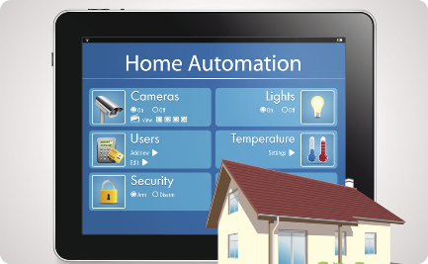
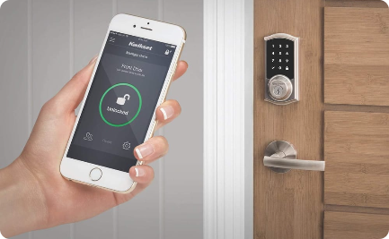
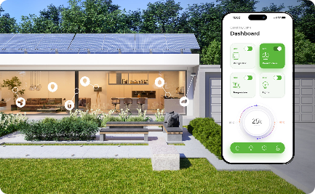
Benefits of Integrating Smart Devices
Convenience & Efficiency
Enhanced Security
Energy Savings
Smart device integration allows for centralized control, automation, and optimization of various home functions, making life easier and more efficient.
Integrating security systems with smart devices enhances home security by providing real-time monitoring, alerts, and remote access.
Smart device integration enables energy monitoring and optimization, resulting in reduced energy consumption and cost savings.

Slide 4

Types of Smart Devices for Home Integration
1
Thermostats
2
Motion Sensors
Control temperature settings, learn preferences, and adjust heating/cooling for optimal comfort and energy efficiency.
Detect motion and trigger actions such as turning on lights, activating cameras, or adjusting security settings based on movement.
3
Cameras
4
Smart Plugs
Monitor surroundings, provide real-time video feeds, and enable remote access for enhanced home security and peace of mind.
Turn ordinary devices into smart devices by enabling remote control, scheduling, and energy monitoring.

Slide 5
Factors to Consider When Selecting Devices
Compatibility
Features & Functionality
User Experience
Ensure that the smart devices you choose are compatible with your existing home automation system or hub.
Evaluate the user experience, ease of setup, and user-friendly interfaces provided by different smart device brands.
Consider the specific features and functionality that each smart device offers to meet your unique needs and preferences.

Slide 6
Best Practices for Integrating Smart Devices
1
Plan & Research
Thoroughly research smart device options, compatibility, and integrations that align with your home automation goals.
Start Small
2
Begin with a few essential devices to familiarize yourself with the integration process before expanding your smart home ecosystem.
3
Secure Your Network
Ensure your home network is protected with strong passwords and encryption to safeguard against unauthorized access to your smart devices.

Slide 7

Future of Smart Device Integration in Homes
Increased Interoperability: Smart devices will become more interoperable, allowing seamless integration across different brands and platforms.
Artificial Intelligence: AI-powered smart home ecosystems will learn and adapt to individual preferences and habits, automating tasks and improving efficiency.
Expansion of IoT: The Internet of Things (IoT) will continue to expand with new devices, creating a more connected and integrated home environment.
Enhanced Data Analytics: Advanced data analytics will enable homeowners to gain valuable insights into energy usage, security patterns, and more.

